Slide 1
Describing Data Using R
© McGraw Hill LLC. All rights reserved. No reproduction or distribution without the prior written consent of McGraw Hill LLC.

Slide 2
Useful Functions
Descriptive Statistics | Excel Function | R Function
Number of data items | COUNT(x) | length(x)
Largest data value | MAX(x) | max(x)
Smallest data value | MIN(x) | min(x)
Mean | AVERAGE(x) | mean(x)
Median | MEDIAN(x) | median(x)
Mode (returns first mode only) | MODE.SNGL(x) | ----------------
Geometric mean (positive data values) | GEOMEAN(x) | exp(mean(log(x)))
Average deviation around the mean | AVDEV(x) | mad(x)
Quartile k = 1, 2, 3 for 25%, 50%, 75% | QUARTILE.EXC(x, k) | quantile(x, p, type=6)
Percentile p e.g., p = .25 for 25% | PERCENTILE.EXC(x, p) | quantile(x, p, type=6)
Sample standard deviation | STDEV.S(x) | sd(x)
Sample covariance for (X,Y) data pairs | COVARIANCE.S(x, y) | cov(x, y)
Population standard deviation | STDEV.P(x) | sqrt(var(x))
Population variance for (X,Y) data pairs | COVARIANCE.P(x, y) | cov(x, y)
Standardize an X value | STANDARDIZE(x, µ, σ) | (x-mean(x))/sd(x)
Correlation coefficient for (X,Y) data pairs | CORREL(x, y) | cor(x, y)
Lm(x~ySlope of simple X-Y regression | SLOPE(x, y) | lm(y~x)
Intercept of simple X-Y regression | INTERCEPT(x, y) | lm(y~x)
R-squared for simple X-Y regression | RSQ(x, y) | cor(x, y)^2

Slide 3
Example
We have 44 observations on price-earnings ratios for a sample of S&P 500 companies. We want to describe the shape of the distribution. First, we import the data to R.
Row-Column Format
One Column
middle rows omitted
Note: R would see each column as a separate variable and would not know what to do with the heading, so we reformat Excel data into a single column with a simple heading.

Slide 4

Import Data
A quick way to import data to R is the clipboard. Highlight the data block in Excel (including its column heading) and copy it to the clipboard using Ctrl+c (Windows) or command+c (MacOS). We will call the imported data PEData. For Windows, enter:
> PEData = read.table(file="clipboard", sep="\t", header=TRUE)
For MacOS, enter:
> PEData = read.table(pipe("pbpaste", sep="\t", header=TRUE)
The argument sep="\t" tells R that the columns are tab-separated. The argument header=TRUE tells R to expect text headings on each column.
Tip1: R doe not want column names that begin with a number or contain special symbols like % and $.
Tip2: An advantage of the clipboard method is that you choose exactly what to import.

Slide 5
View the Data
We told R to store the imported data in an object named PEData. To view the data (44 observations) type the name of the object. The name of the variable is PERatio (the column heading).
> PEData
PERatio
1 59
2 16
20
...
42 9
43 37
44 13
After verifying that the imported data look OK, we can request detailed statistics and/or graphs.
Note: Middle values omitted for brevity.

Slide 6
Describing the Data
Use the summary(x) function to see statistics for PEData and stem(x) to see a stem-and-leaf plot. In stem(x) we insert $ in front of the variable name PERatio because PEData is an object that could contain more than one data column (it doesn't in this case, though we could add some).
> summary(PEData)
PERatio
Min. : 7.00
1st Qu.:13.00
Median :17.50
Mean :20.61
3rd Qu.:24.50
Max. :59.00
> stem(PEData$PERatio)
The decimal point is 1 digit(s) to the right of the |
0 | 79
1 | 000011123334456666778899
2 | 00112346678
3 | 1778
4 | 2
5 | 09
Note: Possibly skewed right because mean exceeds median.
Note: Long upper tail suggests positive skewness. Maybe high extremes?
Note: Stem-and-leaf displays work best for integer data.

Slide 7
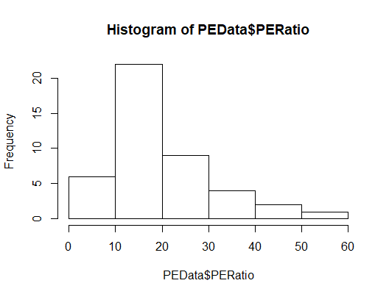
Histogram
Plot a simple histogram using hist(x). The histogram appears in the lower right Files pane. It can be copied to the clipboard or exported to a file.
> hist(PEData$PERatio)
Note: Upper tail is longer, which indicates positive skewness.
Note: We omitted all optional arguments for the hist() function so we got the default number of bins, based on Sturges' Rule (6 bins, 7 axis break points).

Slide 8
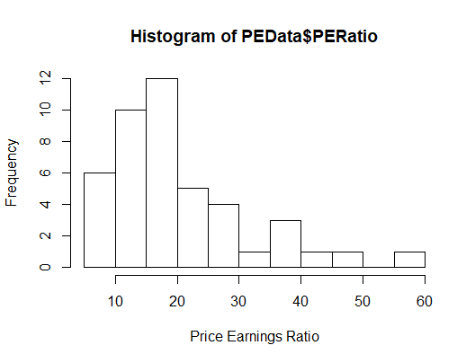
Histogram
To set the number of bins yourself, include the optional argument breaks=k to create k-1 bins. To choose a better axis label, include the xlab argument.
> hist(PEData$PERatio,xlab="Price Earnings Ratio", breaks=12)
For example, we requested 11 bins (12 axis breaks) and axis label “Price Earnings Ratio”.

Slide 9
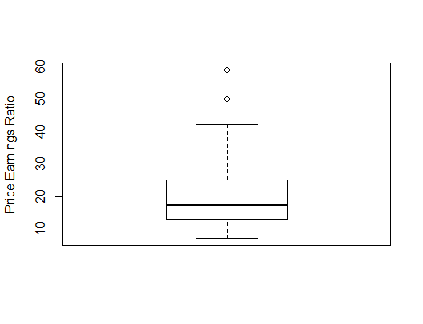

Boxplot
Use boxplot(x) with an optional ylab argument to label the vertical axis. The default boxplot shows the "box" (quartiles q₁, q₂, q₃) and "whiskers" based on the interquartile range (see Note below).
> boxplot(PEData$PERatio,ylab="Price Earnings Ratio")
Note: The upper "whisker" is at q₃+1.5(q₃-q₁). Data values above it are potential outliers. There are no data values below the lower "whisker" at q₁-1.5(q₃-q₁). The whiskers are called the "upper inner fence" and "lower inner fence" respectively.
Note: This definition of "outlier" is not the same as the μ ± 3σ criterion.

Slide 10
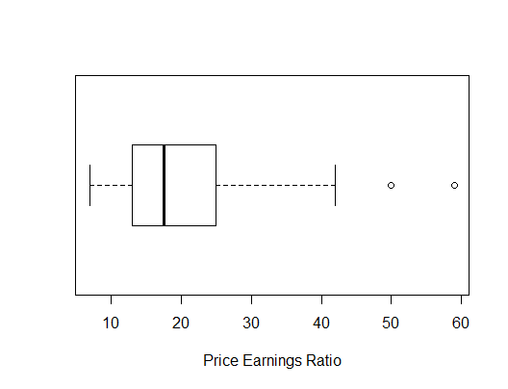
Boxplot
You can get a horizontal boxplot with the optional argument horizontal=TRUE and axis label using xlab instead of ylab.
> boxplot(PEData$PERatio,xlab="Price Earnings Ratio",horizontal=TRUE)
Note: The upper "whisker" location is q₃+1.5(q₃-q₁)
= 24.5+1.5(24.5-13.0)
= 41.75
Note: This definition of "outlier" is not the same as the μ ± 3σ criterion.

Slide 11
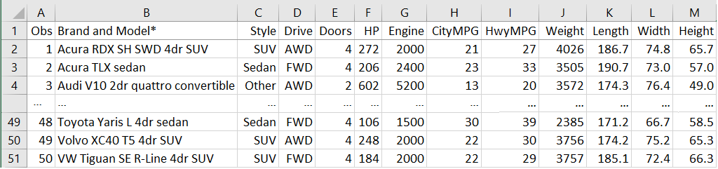
Several Variables
Suppose we have an Excel spreadsheet (50 rows, 13 columns) with data for a sample of 2020 vehicles (abbreviated here). We want to import the data into a data frame in R.
Caution: For import to R we avoid column names that begin with a number or contain symbols like $ or %. Import issues may also arise from Excel's comma or dollar format (e.g., $12,345) depending on how you import the data (e.g., clipboard method).

Slide 12
Data Import
Highlight the data block in Excel (including column headings) and copy it to the clipboard using Ctrl+c (Windows) or command+c (MacOS). Now enter (for Windows):
> VehicleData = read.table(file="clipboard", sep="\t", header=TRUE)
For MacOS you would enter
> VehicleData = read.table(pipe("pbpaste", sep="\t", header=TRUE)
The argument sep="\t" tells R that the columns are tab-separated. The argument header=TRUE tells R to expect text headings on each column.

Slide 13
Descriptive Statistics
We imported our spreadsheet columns to a data frame we named VehicleData. Now we can view the data, calculate statistics, and so on. For example, to calculate average city miles per gallon, we use the function mean(x) where x is the variable name CityMPG in the data frame preceded by $ (the dollar symbol):
> mean(VehicleData$CityMPG)
[1] 21.98
We can get further statistics using the summary() function.
> summary(VehicleData$CityMPG)
Min. 1st Qu. Median Mean 3rd Qu. Max.
13.00 18.00 22.00 21.98 26.00 31.00
Tip: Don't forget the $ symbol before the variable name.

Slide 14
Descriptive Statistics
If our data frame columns have names (as they do here) we can get summary statistics for more than one variable using the summary() function. For example:
> summary(MPGData[c("Weight","Length")])
Weight Length
Min. :2385 Min. :151.1
1st Qu.:3356 1st Qu.:181.9
Median :3662 Median :192.2
Mean :3954 Mean :190.9
3rd Qu.:4661 3rd Qu.:198.7
Max. :5917 Max. :231.9
Tip1: Be careful of syntax, e.g., the square brackets [ ] and quotation marks around variable names.
Tip2: The c() command allows you to select more than one variable.
Tip: The summary() function will work on a data frame with multiple columns. However, summary(VehicleData)would display all 13 variables at once. It may be better to ask only for those columns you need.

Slide 15
Descriptive Statistics
You can refer to columns in your data frame by number. You can use a colon : if your columns are contiguous (e.g., 6 through 8):
> summary(VehicleData[c(6:8)])
HP Engine CityMPG
Min. :106.0 Min. :1400 Min. :13.00
1st Qu.:182.5 1st Qu.:2000 1st Qu.:18.00
Median :249.0 Median :2500 Median :22.00
Mean :262.3 Mean :2898 Mean :21.98
3rd Qu.:308.0 3rd Qu.:3500 3rd Qu.:26.00
Max. :602.0 Max. :6200 Max. :31.00
Tip: The c() command allows you to select more than one variable. Be careful of syntax, e.g., the $ symbol and square brackets [ ].

Slide 16
Descriptive Statistics
If columns are not contiguous (e.g., 6, 8, 11) use commas as separators:
> summary(VehicleData[c(6,8,11)])
HP CityMPG Length
Min. :106.0 Min. :13.00 Min. :151.1
1st Qu.:182.5 1st Qu.:18.00 1st Qu.:181.9
Median :249.0 Median :22.00 Median :192.2
Mean :262.3 Mean :21.98 Mean :190.9
3rd Qu.:308.0 3rd Qu.:26.00 3rd Qu.:198.7
Max. :602.0 Max. :31.00 Max. :231.9
Tip: The c() command allows you to select more than one variable. Be careful of syntax, e.g., the $ symbol and square brackets [ ].
Tip: If you are having trouble keeping track of your variables, the Console pane in the upper left of RStudio has tabs for each data frame. Click on VehicleData and you will see a list of the data.

Slide 17
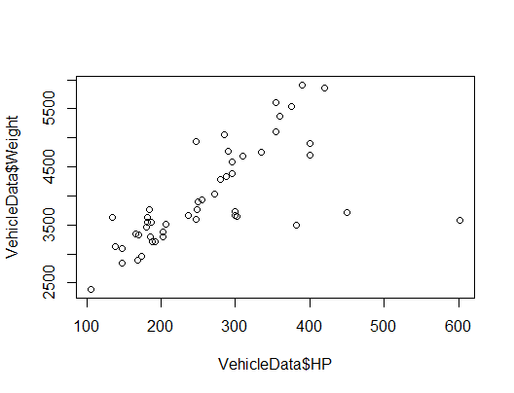
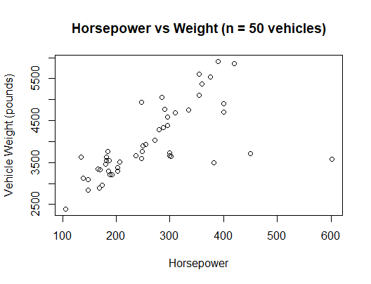
Scatter Plots
Make a scatter plot using the function plot(x, y):
> plot(VehicleData$HP,VehicleData$Weight)
We can create better axis labels using optional arguments xlab and ylab and main to add a title.
> plot(VehicleData$HP,VehicleData$Weight, xlab="Horsepower",
+ ylab="Vehicle Weight(pounds)", main="Horsepower vs Weight
+ (n = 50 vehicles)")
Tip: The $ symbol must precede a variable name.

Slide 18
Correlation vs Regression
Use cor(x,y) to get a correlation coefficient. Here, the correlation (0.65) indicates a strong positive relationship between a vehicle's weight and its horsepower. If you wish to go further, use coef(y~x) or lm(y~x) to see regression coefficients in the linear model y = b₀ + b₁x. Here, we ask whether a vehicle's weight (x) predicts the horsepower of its engine (y). The result says that each extra pound of weight requires .076 extra horsepower. The intercept is meaningless because no vehicle has zero weight.
> cor(VehicleData$HP,VehicleData$Weight)
[1] 0.654359
> coef(lm(VehicleData$HP~VehicleData$Weight))
(Intercept) VehicleData$Weight
-40.20742983 0.07649427
Tip: In correlation, neither variable is designated as "independent" (the predictor) or "dependent" (the response). However, in regression we must state the model explicitly.

Slide 19
Regression
Use summary(lm(y~x)) to see details of the regression. Here, weight "explains" 42.82 percent of variation in horsepower. A multiple regression would perhaps improve the fit (see Chapter 13).
> summary(lm(VehicleData$HP~VehicleData$Weight))
lm(formula = VehicleData$HP ~ VehicleData$Weight)
Residuals:
Min 1Q Median 3Q Max
-103.24 -35.82 -11.89 3.40 368.97
Coefficients:
Estimate Std. Error t value Pr(>|t|)
(Intercept) -40.20743 51.59891 -0.779 0.44
VehicleData$Weight 0.07649 0.01276 5.995 2.55e-07 ***
---
Signif. codes: 0 ‘***’ 0.001 ‘**’ 0.01 ‘*’ 0.05 ‘.’ 0.1 ‘ ’ 1
Residual standard error: 76.42 on 48 degrees of freedom
Multiple R-squared: 0.4282, Adjusted R-squared: 0.4163
F-statistic: 35.94 on 1 and 48 DF, p-value: 2.549e-07

Slide 20
Correlation Matrix
It would be tedious to check correlations one pair at a time (our data frame VehicleData has 17 columns). To get a correlation matrix, we first create a new data frame (called a tibble) containing only the numerical variables of interest (excluding vehicle brand, body style, etc). We select 9 interesting variables and copy them into NumData.
> NumData=VehicleData[c(5:13)]
> NumData
# A tibble: 50 x 9
Doors HP Engine CityMPG HwyMPG Weight Length Width Height
<dbl> <dbl> <dbl> <dbl> <dbl> <dbl> <dbl> <dbl> <dbl>
1 4 272 2000 21 27 4026 187. 74.8 65.7
2 4 206 2400 23 33 3505 191. 73 57
3 2 602 5200 13 20 3572 174. 76.4 49
4 4 382 2998 22 30 3489 186. 71.9 56
5 4 335 3000 21 26 4758 194. 78.9 68.7
6 4 310 3600 17 25 4685 204. 78.8 69.9
7 4 250 2000 22 32 3902 193. 73.3 57.3
8 4 237 2000 23 32 3660 194. 74.1 57.2
9 4 420 6200 14 21 5856 204. 80.5 74.4
10 4 170 1500 26 31 3325 183. 72.6 65.4
# … with 40 more rows

Slide 21
Correlation Matrix
After verifying that NumData contains the desired data, we request a correlation matrix using cor() but replacing x and y with NumData. We round the correlation coefficients to two decimals for clarity. Note that each variable is perfectly correlated with itself, and the previous correlation (0.65) between Weight and HP.
> round(cor(NumData),2)
Doors HP Engine CityMPG HwyMPG Weight Length Width Height
Doors 1.00 -0.34 -0.20 0.20 0.15 0.10 0.32 0.09 0.38
HP -0.34 1.00 0.81 -0.85 -0.77 0.65 0.50 0.71 0.20
Engine -0.20 0.81 1.00 -0.85 -0.77 0.73 0.57 0.68 0.39
CityMPG 0.20 -0.85 -0.85 1.00 0.95 -0.84 -0.60 -0.77 -0.49
HwyMPG 0.15 -0.77 -0.77 0.95 1.00 -0.84 -0.55 -0.75 -0.62
Weight 0.10 0.65 0.73 -0.84 -0.84 1.00 0.74 0.82 0.77
Length 0.32 0.50 0.57 -0.60 -0.55 0.74 1.00 0.76 0.60
Width 0.09 0.71 0.68 -0.77 -0.75 0.82 0.76 1.00 0.60
Height 0.38 0.20 0.39 -0.49 -0.62 0.77 0.60 0.60 1.00

Slide 22
Manipulating Data
We can create data within R. One way is to use the concatenate function c(). Then we can then do other useful things. For example:
> x1=c(4,5,6) # create a vector containing 4,5,6
> x1
[1] 4 5 6
> x2=c(7,8,9) # create a vector containing 7,8,9
> x2
[1] 7 8 9
> x3=c(x1,x2) # stack the two vectors into one column
> x3
[1] 4 5 6 7 8 9
> xdata=data.frame(x1,x2) # put both vectors columns into a data frame
> xdata
x1 x2
1 4 7
2 5 8
3 6 9

Slide 23
Random Data
Example 1: Create 25 random integers between 1 and 999.
> sample(1:999,25)
[1] 294 358 409 766 760 927 513 185 885 29 444 274 187 828 709 108 749 9
[19] 887 874 653 912 696 611 661
Example 2: Create 25 decimal observations from a normal distribution
with mean 100 and standard deviation 15. Round them to integers.
> Data1=rnorm(25,100,15) # Generate 25 random N(100,15)
> Data1 # list the data we have created
[1] 105.78153 112.62881 97.86053 95.25282 98.39782 88.48118 78.23761
[8] 95.86220 110.26956 118.48021 98.41509 116.24194 102.59046 119.65684
[15] 70.61914 112.47272 104.25433 99.06648 111.05391 97.01341 128.98725
[22] 105.95539 79.86504 62.50125 66.75198
> Data2= round(Data1,0) # round the sample data into integers
> Data2
[1] 106 113 98 95 98 88 78 96 110 118 98 116 103 120 71 112 104 99
[19] 111 97 129 106 80 63 67

Slide 24

Python
Python is a general application development environment (not just statistics). R is often included in Python along with other statistics and data analytics packages. Students can then enjoy seamless access to these tools within Python.
What is Python?
Python is a free, object-oriented, high-level programming language used for rapid application development. Its is attractive because of its easy to learn syntax and support for specialized modules (e.g., R). Besides R, there are many Python add-in packages for statistical analysis (e.g., Pandas, SciPi) as well as basic Python modules (e.g., statistics, statsmodels, random).
For more info: https://www.kaggle.com/learn/python

Slide 25
Python
The statistics module for Python offers basic functions for math and descriptive statistics (e.g., mean, median, quantiles, geometric mean). The statsmodels module allows estimation of different statistical models, statistical tests, and data exploration. But R is more general
Python Statistics
Although Python may offer you many statistical tools, your instructor may focus on R for simplicity. If you pursue a career in data science, you will need to learn which package is best for each application. But introductory students who only need to manipulate or describe data may be satisfied with Excel. Or Minitab or JMP or MegaStat for quick statistical tests without programming,

Slide 26
Anaconda
Python installations with Anaconda include SciPy (common statistical tests). Often, they also include the R Essentials bundle and other popular tools for data science (e.g., IRKernel, dplyr, shiny, ggplot2, tidyr, caret, nnet).
What is Anaconda?
Anaconda free open-source distributor of both Python and R. Anaconda is widely used in the scientific community and by data scientists for machine learning projects or data analysis. It permits easy updating of tools and packages in an integrated environment by a site administrator. Without creating their own Anaconda installation, introductory students are probably better off enjoying sites managed by the university.

Slide 27

Advice
Excel data analysis ...
Pro: familiar, easy to insert functions
Pro: intuitive custom formatting and sharing
Con: limited options for deeper analysis
R data analysis ...
Pro: quick and logical once you get used to R
Pro: allow unlimited fancy statistical tests
Con: require training and frequent syntax Help
Alternatives ... Minitab? JMP?

